Slide 1
In the name of god
Prospect 3
Lesson 1
By Ali Tahmasebi
9oom.rozblog.com/

Slide 2
راهنمایی
این پاورپینت به صورت کلیکی طراحی نشده است برای جابجایی بین اسلاید ها از نشانک ها استفاده کنید.یا به فهرست برگشته و به بخش مورد نظر بروید.
این پاورپینت فقط بر روی powerpoint 2010 و بالا تر از آن به خوبی اجرا می شود.
برای تهیه این فایل زحمات زیادی کشیده شده است لطفا از کپی کردن بدون ذکر منبع آن بپرهیزید.

Slide 3
contents
9oom.rozblog.com
Conversation
Key Language
Vocabulary
Grammar
Language Melody

Slide 4
Conversation
Listen to the conversation between two cousins.
9oom.rozblog.com
Ehsan: Who is your best friend at school?
Parham: Reza.
Ehsan: What’s he like?
Parham: Oh, he is really great! He’s clever and kind.
Ehsan: Is he hard-working too?
Parham: Yes! And he’s always very helpful.
Ehsan: How?
Parham: He always helps me with my lessons.
Key Language
Vocabulary
Grammar
Language Melody

Slide 5
Key Language
Listen to the examples. Then ask and answer with a friend.
Are you hard-working?
Is he clever?
Is Zahra talkative?
Are they neat?
Are they upset?
Yes, I am.
Yes, he is.
No, she isn’t.
Yes, they are.
No, they’re not.
9oom.rozblog.com
Conversation
Vocabulary
Grammar
Language Melody

Slide 6
Key Language
Listen to the examples. Then ask and answer with a friend.
What’s your friend like?
What’s your mother like?
What’s he like?
What’s she like?
What are you like?
What are they like?
He’s very funny.
She’s very kind and patient.
He is quiet.
She is clever.
I’m a bit serious.
They are very kind.
9oom.rozblog.com
Conversation
Vocabulary
Grammar
Language Melody

Slide 7
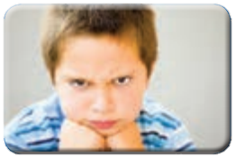
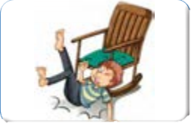
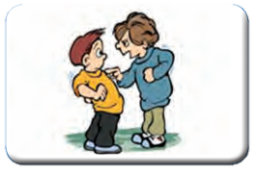
Vocabulary
back
next
Lesson 1 Personality
9oom.rozblog.com
an angry kid
a brave soldier
a careless man
a cruel boy
a funny story
a neat person
Photo Dictionary
Key Language
Vocabulary
Grammar
Language Melody

Slide 8
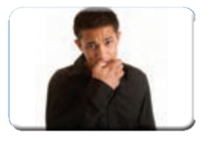
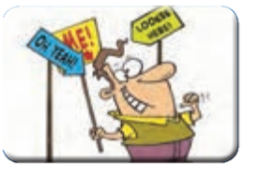
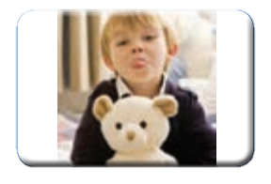
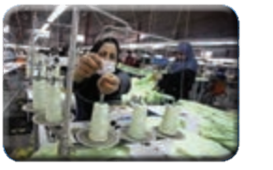
Vocabulary
back
next
Lesson 1 Personality
9oom.rozblog.com
a nervous boy
a selfish person
a pleasant environment
a rude kid
a quiet place
a hard-working worker
Photo Dictionary
Key Language
Vocabulary
Grammar
Language Melody

Slide 9
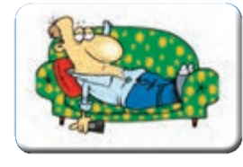
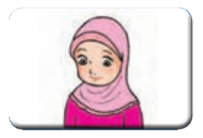
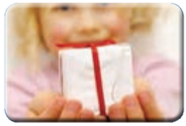
Vocabulary
back
next
Lesson 1 Personality
9oom.rozblog.com
a lazy person
a shy girl
a generous girl
More words
Photo Dictionary
Key Language
Vocabulary
Grammar
Language Melody

Slide 10
Grammar
“to be” verbs
Affirmative
I | am | happy
He She | is
We You They | are
Question
Am | i | happy?
Is | he she
Are | we you they
I am not talkative. = I’m not talkative.
He is not shy. = He’s not shy. = He isn’t shy.
They are not rude. = They’re not rude. = They aren’t rude.
There | is | an | eraser | in the classroom.
 |  | a one | computer
 | are
 |  | two three many some | students
9oom.rozblog.com
Key Language
Vocabulary
Conversation
Language Melody

Slide 11
Language Melody
Listen to the conversation and pay attention to the intonations of “affirmative” sentences.
Teacher: Farzaneh is a clever student. Everybody likes her.
Samira: Yes. I know. She is also very helpful.
Teacher: Well, you can ask her for help.
Samira: Ok, I’ll ask her to help me with my English.
9oom.rozblog.com
Key Language
Vocabulary
Grammar
Conversation

